Slide 1
Post Incident Operations
CGPRT(W) : Ensuring Clean Seas and Coasts in Western Region ……

Slide 2
Objectives
To understand the required post-incident operations after an oil spill.
To understand the consideration of any post-spill monitoring or studies.
CGPRT(W) : Ensuring Clean Seas and Coasts in Western Region ……

Slide 3
Post-incident Operations
Once active clean-up is terminated, many tasks must be accomplished to complete the response.
Generally, four types of tasks are carried out:
  Operational tasks;
  Administrative tasks;
  Post-spill studies (they will generally commence as necessary and be integrated with the response operations);
  Restoration.
This project phase can last for a long period of time depending on the scale of the incident.
CGPRT(W) : Ensuring Clean Seas and Coasts in Western Region ……

Slide 4
Post-incident Operations
Operational tasks
  All equipment and stockpiles used for the response must be returned to their original state of readiness.
  Ensure that equipment is ready for next spill.
  Typical operational tasks are:
    Remove equipment from field
    Clean up of equipment, waste area, ports, vessels, etc.
    Repairs and maintenance
    Restock.
CGPRT(W) : Ensuring Clean Seas and Coasts in Western Region ……

Slide 5
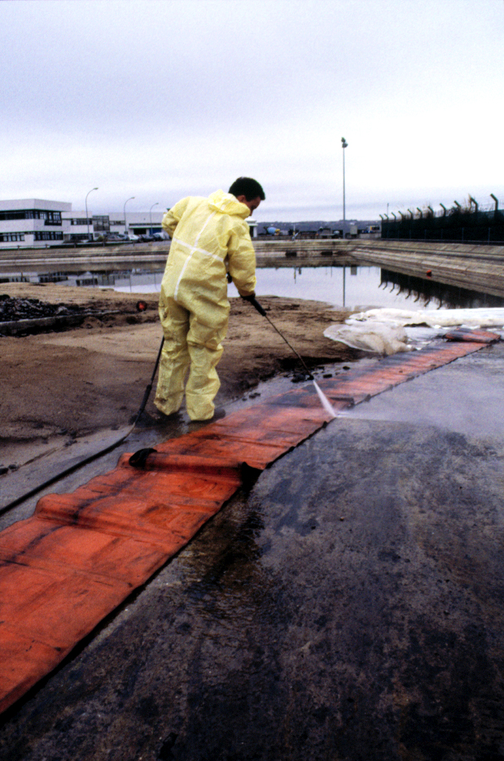
Post-incident Operations
CGPRT(W) : Ensuring Clean Seas and Coasts in Western Region ……

Slide 6
Post-incident Operations
Administrative tasks
  A number of administrative tasks must be completed once active clean-up is terminated.
  Typical administrative tasks are:
    Finalize payments and contracts
    Compile costs
    Produce final incident report
    Prepare claims
    Conduct incident debriefing
    Implement lessons learned
CGPRT(W) : Ensuring Clean Seas and Coasts in Western Region ……

Slide 7
Post-incident Operations
Post-spill studies
  Undertaken as necessary to:
    determine the nature and extent of damage
    assess and monitor the recovery processes
  Typically, post-spill studies will start during response and continue after operations are concluded
Post-spill monitoring must answer specific questions such as:
  What are the levels of contaminants in the environment?
CGPRT(W) : Ensuring Clean Seas and Coasts in Western Region ……

Slide 8
Post-incident Operations
Designing a post-spill monitoring study
  Determine monitoring objectives
    Ex: evaluate hydrocarbon levels in sediments
  Determine geographical extent
    Ex: Beach 1 and 5
  Determine study parameters
    Ex: Total hydrocarbons
  Elaborate sampling plan
    Ex: Monthly, 5 sampling stations, 3 samples/station
CGPRT(W) : Ensuring Clean Seas and Coasts in Western Region ……

Slide 9
Post-incident Operations
Designing a post-spill monitoring study
  Determine study timeframe
    Ex: 12 months
  Decide on interpretation of results
    Comparison with pre-spill data
    Comparison with non-contaminated reference sites
    Changes over time
  Carry out study and write report
  Identify required restoration measures
CGPRT(W) : Ensuring Clean Seas and Coasts in Western Region ……

Slide 10
Post-incident Operations
Collaboration between government and ship/facility owner is desirable during the whole process
It will avoid:
  Duplication of efforts
  Varying results due to differences in methodology
  “Battle of experts”
Collaboration will ensure quicker implementation of restoration measures and treatment of claims
CGPRT(W) : Ensuring Clean Seas and Coasts in Western Region ……

Slide 11
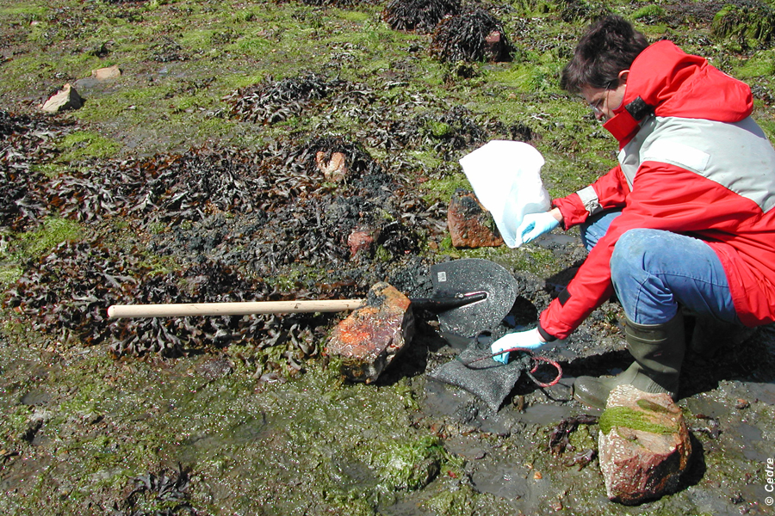
Post-incident Operations
CGPRT(W) : Ensuring Clean Seas and Coasts in Western Region ……

Slide 12
Post-incident Operation
Restoration
  Measures to speed up recovery from environmental damage
  Aim to bring back environmental function to what it was prior to a spill
  Various methods:
    Planting (mangroves, marshes)
    Restricting access to particular habitat
    Predator control
  Must have a realistic chance of success for compensation
CGPRT(W) : Ensuring Clean Seas and Coasts in Western Region ……

Slide 13
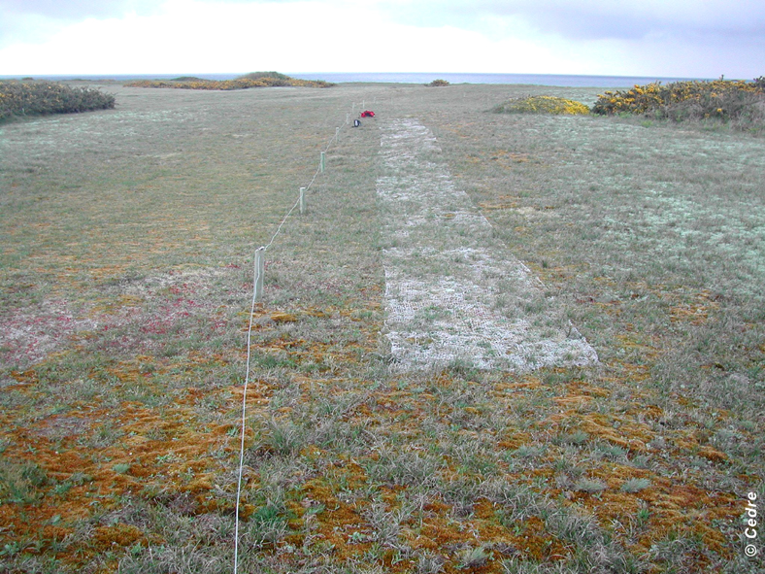
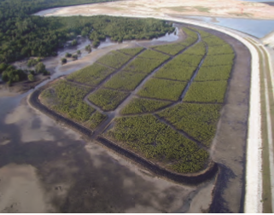
Post-incident Operation
CGPRT(W) : Ensuring Clean Seas and Coasts in Western Region ……

Slide 14
Conclusion
Many tasks must be undertaken after active clean-up to terminate an oil spill response.
It is important to plan for those during the response and to keep resources available.
Adopt a collaborative approach for the design of post-monitoring studies.
CGPRT(W) : Ensuring Clean Seas and Coasts in Western Region ……

Slide 15
Any questions?
CGPRT(W) : Ensuring Clean Seas and Coasts in Western Region ……

